Slide 1
Vital Intelligence
Passive food logging. Personal Metabolic Awareness
CONCEPT STAGE
CONSUMER WELLNESS ONLY
NOT A MEDICAL DEVICE

Slide 2

Manual Food Tracking Doesn't Work
80%
0
give up within a month
No Reliable Data
Most people start strong, then life gets in the way.
What we remember eating rarely matches what we actually ate.
0
No Useful Context
Doctors and dietitians are still working off guesswork.

Slide 3
MEET MEGAN
38 · Weight Management · Tried Every Food Diary App
"I know I should track what I eat. But after a long day, I just can't face logging every meal."
Megan isn't alone. Millions of people want to eat better but burn out before the habit sticks.

Slide 4
Built for Real People, Not Perfect Ones
Weight Management
Metabolic Health
They know tracking works but they just can't keep it up.
Looking for patterns, not just calorie counts.
General Wellness
Calorie Trackers
Curious about their health, but not looking for clinical tools.
Already tracking , just exhausted by the manual effort.

Slide 5
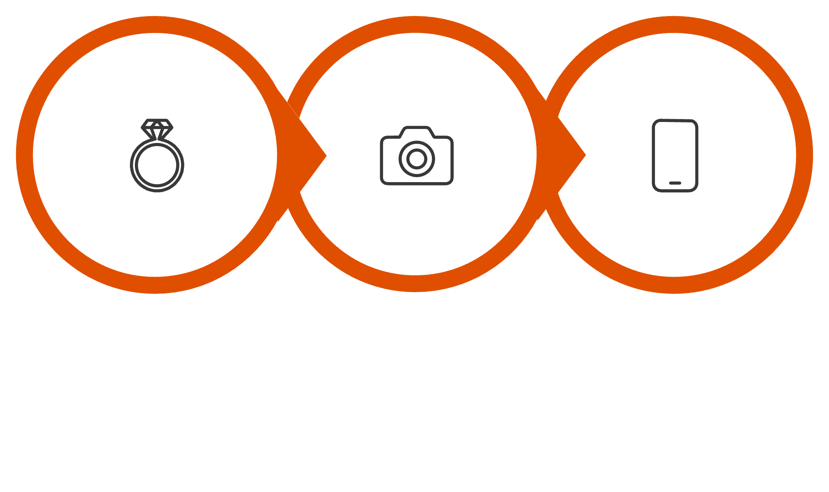
How It Works: Three Parts
Wearable Detects
Camera Captures
App Summarizes
From your meal to your evening summary fully automatic and insights provided based on your metabolic response.

Slide 6
What a Typical Day Actually Looks Like
8:05 am — Eating Event Detected
Ring picks up gesture, HR rise & low movement. Event fires silently.
8:05 am — Camera Captures the Meal
A brief silent photo captures the meal. Megan doesn't even look up.
8:05 am — Food Identified & Logged
Scrambled eggs & toast — 380 kcal. No notification sent.
8:05–9:35 am — Biometric Window Opens
HR, HRV & skin temperature tracked for 90 minutes.
1:10 pm — Lunch Flagged
Her body reacts differently to pasta today. Quietly noted — nothing sent yet.
8:00 pm — Evening Narrative Delivered
One relaxed summary of her day.
Along with suggestion if something stood out.

Slide 7

Nothing Gets Flagged Without Good Reason
During the first 2–3 weeks, VI observes everything and builds your personal baseline
G1 Event Confirmed
G2 Exercise/Movement
Once your baseline is set, VI quietly tracks what’s routine and
only surfaces what genuinely deviates –
relative to you, your habits, and your health goals.
Only triggers after a real meal — not random activity.
If there is exercise/movement after meal, its measured and captured.
G3 Stress
G4 Snack gets tracked
If the wearable picks up stress signals after a meal, VI flags it for your confirmation . Over time, it learns how stress typically shows up for you.
Grazing or snacking couple of hours after meal , gets included too
G5 No Confounders
Bad sleep, feeling unwell, or a lot of caffeine? The window is set aside.

Slide 8
Your Evening Summary: Simple, Calm, Honest
Every summary ends with either one clear suggestion, or a reassurance that everything looks fine.
Mode 1 : Quiet
Mode 2 : Emerging
All consistent. "4 eating events. Sleep 7h 30m. All meals within your personal patterns. Keep it up."
Pattern seen 1–2×. "1pm pasta - stronger response than usual. Second time this week. Try the smaller portion."
Mode 3 : Confirmed
Pattern 3+ times. "Pasta flagged three times. Try adding protein. Worth raising with a dietitian - no urgency."

Slide 9
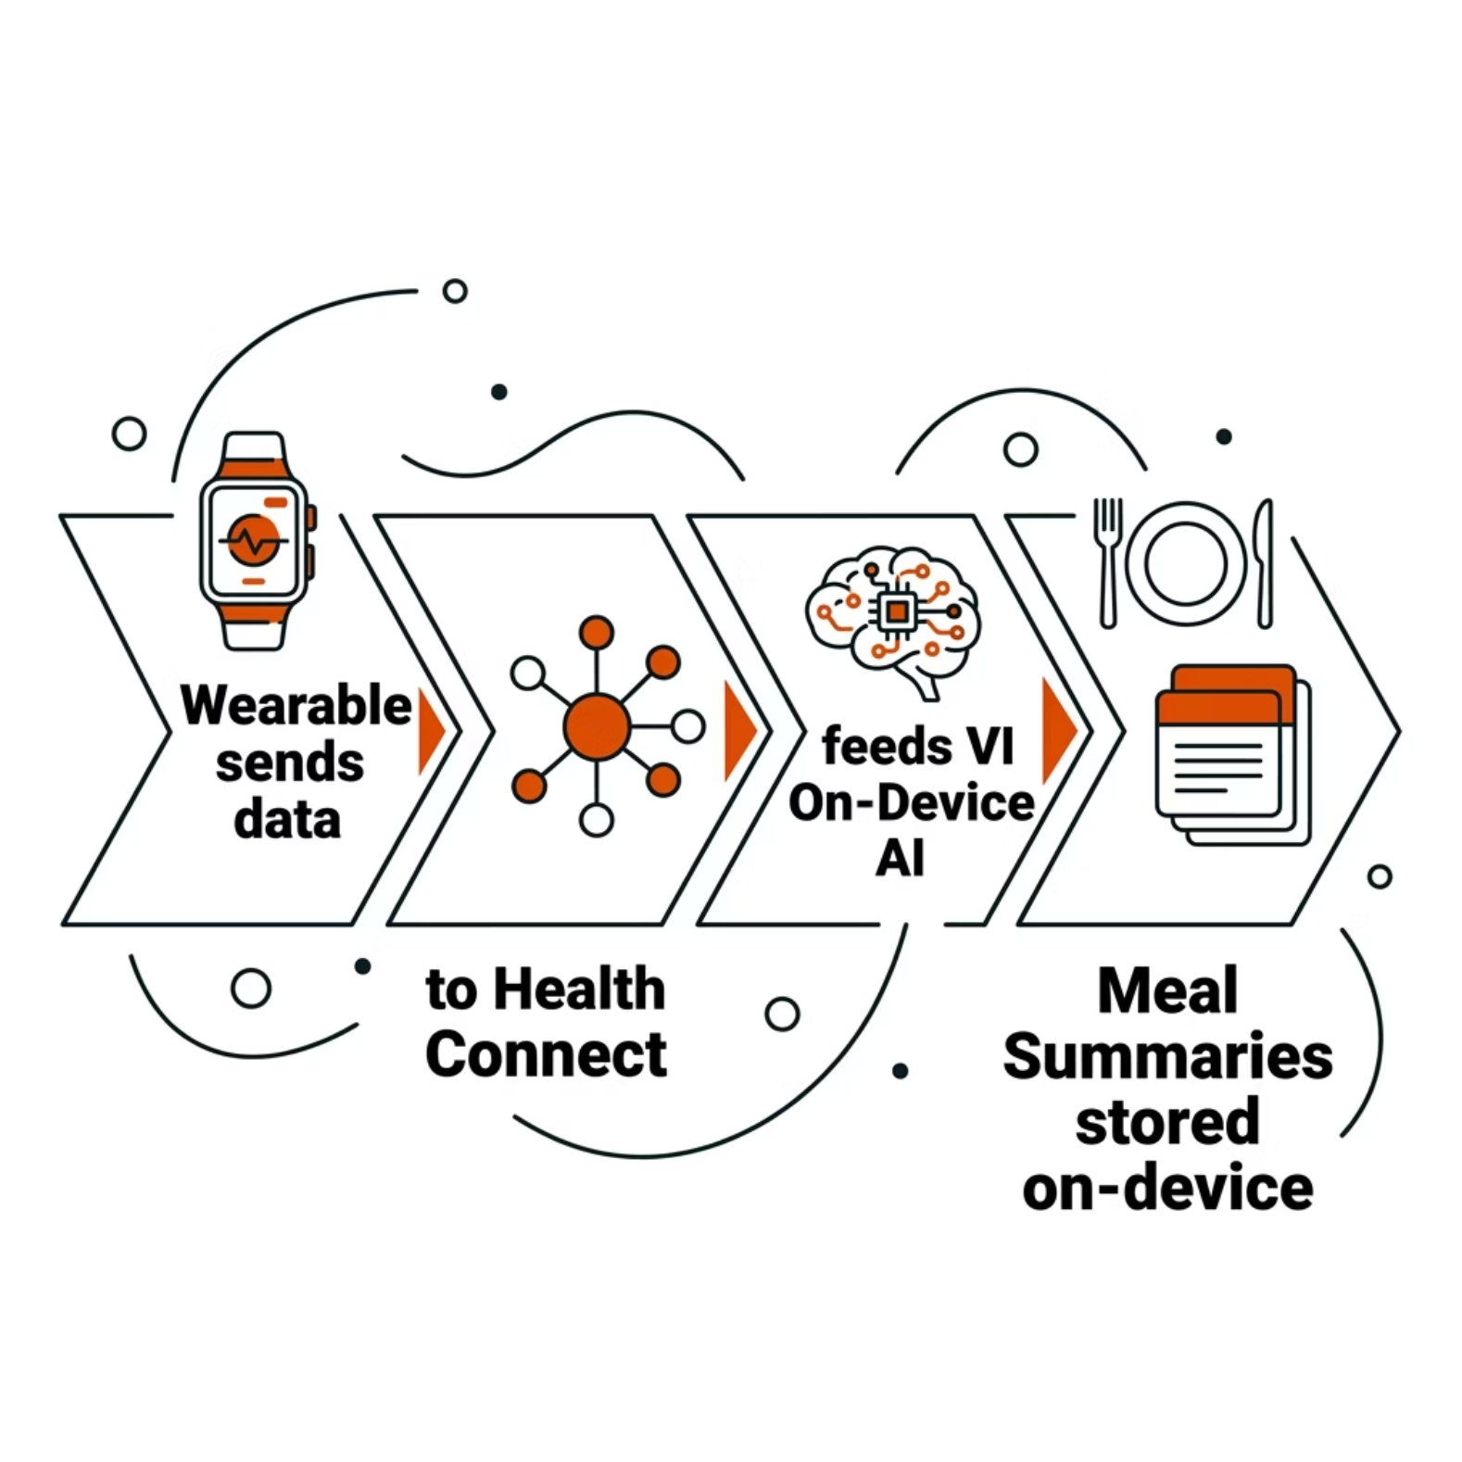
Your Data Stays With You — Always
Food Images
Analysed on your phone the moment the photo is taken. Deleted right after. Never stored, never sent.
Raw Biometric Signal
Kept briefly while the system checks for patterns. Cleared as soon as the checks are done.
Meal Summaries
Only the summary stats are kept - stored locally on your device to build your personal baseline over time.
No Cloud DB
There is no Vital Intelligence server. Nothing ever leaves your device.
Health Connect
Reads your sleep data from Apple Health or Google Health each morning. Doesn't write anything back.

Slide 10
From Guesswork to Real Patterns
Today
With Vital Intelligence
A rough 3-day memory of what you think you ate
A complete record of every meal — captured automatically
Best guesses on portion sizes
Photo-based estimates, with you confirming anything unclear
No idea how your body actually responded
Real patterns showing how your body responds to specific foods
Most people quit within two weeks
Keeps working quietly, whether you're paying attention or not
Open Questions
Can we reliably detect real, personal metabolic patterns from passive biometric signals , not just noise?
Technical feasibility of camera integrated in ring/wearable
Accuracy of eating event detection using gyroscope in wearables via hand-mouth gesture
User adoption for wearables with camera
VITAL INTELLIGENCE · CONCEPT STAGE · NOT A MEDICAL DEVICE

Slide 11
Link to Prototype – https://vital-intelligence.ai.studio
Link to video demo –
https://www.loom.com/share/abd4ce507395400f8965f8f8378cb9de

